Slide 1
Rock Identification Using Deep Convolution Neural Networks & IBM Watson

Slide 2
Rocks are a fundamental component of earth. The automatic identification of rock type in the field would aid geological surveying, education, and automatic mapping. It is a basic part of geological surveying and research, and mineral resources exploration.

Slide 3
In this project rock classification we are going to find the type of rock such as 'blue calcite', 'limestone', 'marble', 'olivine' and 'red crystal' were we are using CNN model to analyse the type of rock. The objective of the project is to build a web application to detect the type of the rock. The model takes input from the user and compares it with the pre trained model and the rock type is classified and showcased on the UI along with its chemical composition.

Slide 4
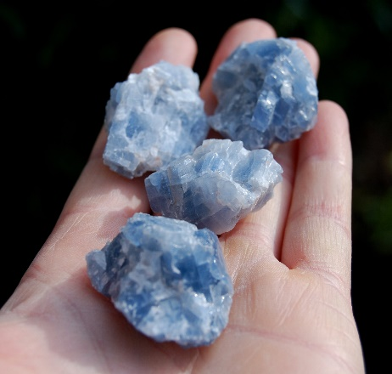
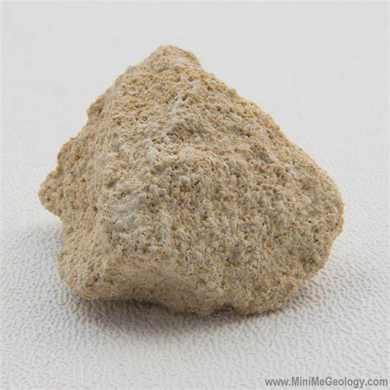
Types of rocks Blue calcite:
Calcite is a carbonate mineral and the most stable polymorph of calcium carbonate (CaCO3). The Mohs scale of mineral hardness, based on scratch hardness comparison, defines value 3 as "calcite".
LIMESTONE: Limestone is a common type of carbonate sedimentary rock. It is composed mostly of the minerals calcite and aragonite, which are different crystal forms of calcium carbonate (CaCO3). Limestone forms when these minerals precipitate out of water containing dissolved calcium.

Slide 5
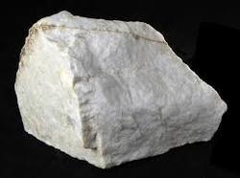
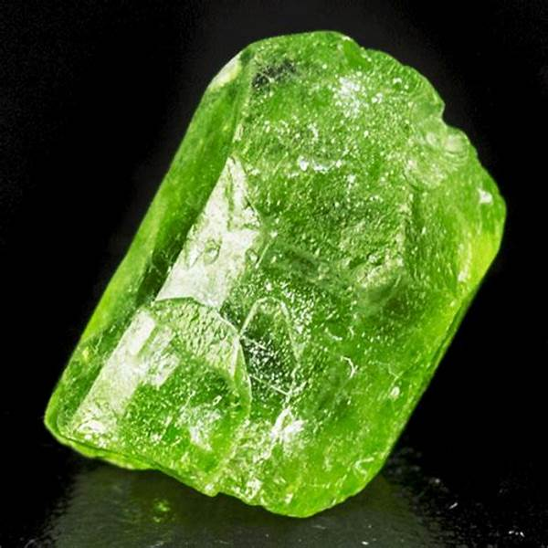
Marble:
Marble is a metamorphic rock formed when limestone is exposed to high temperatures and pressures. Marble forms under such conditions because the calcite forming the limestone recrystallises forming a denser rock consisting of roughly equigranular calcite crystals.
OLIVINE:The mineral olivine (/ˈɒl.ɪˌvin/) is a magnesium iron silicate with the chemical formula (Mg2+, Fe2+)2SiO4. It is a type of nesosilicate or orthosilicate. The primary component of the Earth's upper mantle,[8] it is a common mineral in Earth's subsurface, but weathers quickly on the surface.

Slide 6
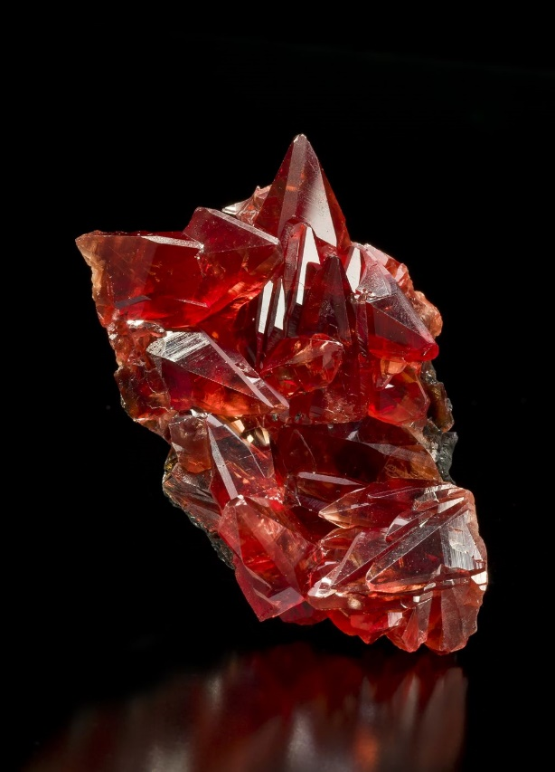
Red CrYSTAL : a crystal or crystalline solid is a solid material whose constituents (such as atoms, molecules, or ions) are arranged in a highly ordered microscopic structure, forming a crystal lattice that extends in all directions.in addition, macroscopic single crystals are usually identifiable by their geometrical shape, consisting of flat faces with specific, characteristic orientations.

Slide 7
For completion and getting the result of this project , the following steps are needed to be completed:
1.Data Collection – Collection of data is the foremost task in any project . In convolutional Neural networks, as it deals with images, we need training and testing data set. it is the actual data set used to train the model for performing various actions.

Slide 8
Image Preprocessing:
The second step of the project is image preprocessing . Image preprocessing are the steps taken to format images before they are used by model training and inference. Image preprocessing also improves the quality of the images and and helps to analyse in a better way .
image pre-processing includes the following main tasks
import image data generator library.
configure image data generator class.
applying image data generator functionality to the trainset and test set.

Slide 9
Model Building
We are ready with the augmented and pre-processed image data, Lets begin our model building, this activity includes the following steps
Import the model building Libraries
Initializing the model
Adding CNN Layers
Adding Hidden Layer
Adding Output Layer
Configure the Learning Process
Training and testing the model
Saving the model

Slide 10
Application Building
In this section, we will be building a web application that is integrated into the model we built. A UI is provided for the uses where he has uploaded an image. The uploaded image is given to the saved model and prediction is showcased on the UI.
This section has the following tasks
Building HTML Pages
Building server-side script

Slide 11
Train The Model On IBM
In this milestone, you will learn how to build Deep Learning Model Using the IBM cloud.

